Slide 1

Exploring dynamics of older adults’ smartphone usage in China:
Mental health, using preferences, smartphone dependency
Yiting Liu, Siyue Li, Shiyu Han, Xiaoting Liu
Zhejiang University
College of Communication and International Culture
2024/7/2

Slide 2
Background
The increasing Internet penetration rate
According to China Internet Network Information Center (CNNIC; 2022), nearly 119 millions of older adults have access to the Internet by the end of 2021.
The popularity of smartphones among Chinese older adults
Among them, 99.5% of the elderly Internet users possessed and used smartphones.

Slide 3
Benefits vs Drawbacks
Loneliness alleviation
Basic life needs gratification
……
Online fraud
Problematic smartphone use
……
(Busch et al., 2021; Lei et al., 2022; Shang et al., 2022)

Slide 4
Research focus: Smartphone dependency
Digital
natives
What we want to do?
The interactions between:
Different smartphone using patterns
Mental health
Smartphone dependency
Adolescents
The elderly
Digital immigrants
(Nahas et al., 2018; Seifert & Schelling, 2015; Yu & Sussman, 2020)

Slide 5
Literature review
Uses and Gratifications Theory/Technology Acceptance Model…
Five functions
Desire to integrate into the society
Lifestyle
Use different functions on smartphones
Process use
Entertainment
Social
Necessity to meet daily life needs
Information
Social use
Production
(Blumler, 1979; Davis, 1989; Park et al., 2013; Song et al., 2004)

Slide 6





Literature review
Functional dependency
Smartphone dependency
Existential dependency
?
……
H1：Older adults’ use of a) lifestyle functions, b) entertainment functions, c) social functions, d) information functions and e) production functions on smartphones are positively associated with their smartphone dependency.
(Elhai et al., 2017; Song et al., 2004; van Deursen et al., 2015)

Slide 7
Literature review
Self-Determination Theory
Competence: to be competitive
Autonomy: to take a control of what they would perform
Relatedness: to be included and supported
Better behavioral control
Positive attitudes towards ageing
Active participation in social activities
……
H2：Older adults’ attitudes towards ageing are negatively associated with their smartphone dependency.
(Deci & Ryan, 2000; McConatha et al., 2003; Lu 2012)

Slide 8
Literature review
Live alone
Restricted physical mobility
Declining cognitive ability
Mental health
Unclear relationships
Smartphone dependency
Mental health
?
H3: Older adults’ perceived mental health is negatively associated with their smartphone dependency.
(Yang et al., 2016; Zhitomirsky-Geffet & Blau, 2016)

Slide 9
Literature review
Objective functions
Subjective perceptions
Mental health
Using preferences
Ageing attitudes
RQ1: How is older adults’ use for different smartphone functions associated with their perceived mental health and smartphone dependency?
H4: Older adults’ perceived mental health mediates the relationship between older adults’ attitudes towards ageing and their smartphone dependency.
?
Smartphone dependency
（Park, 2019; Kim et al., 2013）

Slide 10
Methods
Males（n=153, 48%）
Females（n=166, 52%）
Final samples（N=319, M=71.81, SD=7.087）
Participants
Older adults aged 60 and above
Have used smartphones
Sampling and measurement tool
Stratified sampling: different towns in Zhejiang Province of China, 10 years old as an age cohort
Questionnaires in paper form were distributed through home visiting
Data analysis
Zero-order Correlation
Process: mediation analysis

Slide 11
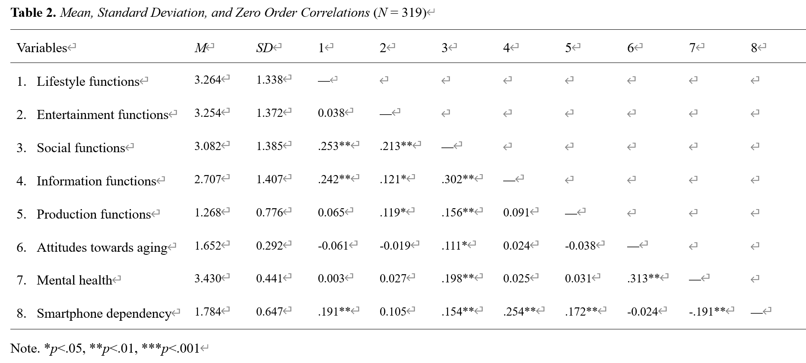
Results
Older adults’ dependency on smartphones was negatively related to their mental health, while positively associated with frequent uses of four of the defined functions.

Slide 12
Results
Table 3. The total, direct and indirect effects among key variables
 | Mediator: Perceived mental health
 | b | SE | LLCI | ULCI
Lifestyle functions
Total effect | .0922 | .0267 | .0396 | .1447
Direct effect | .0924 | .0262 | .0408 | .1440
Indirect effect | -.0003 | .0058 | -.0122 | .0110
Social functions
Total effect | .0702 | .0261 | .0190 | 1215
Direct effect | .0916 | .0259 | .0406 | .1426
Indirect effect | -.0213 | .0095 | -.0429 | -.0058
Information functions
Total effect | .1182 | .0251 | .0689 | .1675
Direct effect | .1205 | .0246 | .0721 | .1688
Indirect effect | -.0023 | .0059 | -.0136 | .0103

Slide 13
Results
 | Mediator: Perceived mental health
 | b | SE | LLCI | ULCI
Production functions
Total effect | .1430 | .0464 | .0516 | .2344
Direct effect | .1481 | .0456 | .0584 | .2378
Indirect effect | -.0051 | .0090 | -.0217 | .0153
Attitudes towards ageing
Total effect | -.0497 | .1244 | -.2944 | .1951
Direct effect | .0917 | .1287 | -.1615 | .3449
Indirect effect | -.1414 | .0594 | -.2718 | -.0407
H3 and H4 was supported while H1 was partially supported but H2 was not supported.
RQ1：The indirect effect of older adults’ preferences for social functions, mediated through their mental health on their smartphone dependency was significant.

Slide 14
Discussion
Different using preferences
Attitudes towards ageing
A complex psychological process
Successful ageing
Older adults’ social lives and their mental health
Reasonable smartphone use vs Social relationships establishment and maintenance
Basic life needs | VS | Digitalized trends
Desire for connection |  | Simple social network
Earn a living |  | Thrifty qualities
A life tool |  | A time killer

Slide 15
Limitations
A cross-sectional design
Longitudinal changes of perceptions
Casual relationships
Self-reported data
Cognitive declination, biased memories…
Sampling
Zhejiang Province, a relatively rich and advanced region in China
Combined survey methods
Some interesting answers to open-ended questions while a qualitative survey is suggested.

Slide 16
Thanks for your listening!

Slide 17
Q & A

